Slide 1

FORECASTING US-HTG EXCHANGE RATE IN HAITI
A MACHINE LEARNING APPROACH
By Grégory PINCHINAT

Slide 2

PLAN
INTRODUCTION
METHODOLOGY
DATA SOURCES
QUICK FACTS & FIGURES
EFFECT OF PUBLIC & ECONOMIC POLICIES?
IMPACT OF VARIOUS FACTORS
FORECASTING THE EXCHANGE RATE
COMPARISONS OF TWO FORECASTING MODELS
CONCLUSIONS & RECOMMENDATIONS
THANKS, ANNEXES & REFERENCES

Slide 3

INTRODUCTION
With the Exchange Rate being unstable, the average consumer in Haiti is always worried about how the US Dollar value will vary over the next few days, or even hours. The problem is, when the US-HTG Exchange rate spikes, prices of good and services also spike, because of our imports-based market structure.
This study aims at adding value to the adaptative anticipations of consumers and of young entrepreneurs, by trying to provide them with pieces of precise, but not necessarily exact, prediction information on the value of U$ 1 (one) in gourdes, by the end of the nearest future month.

Slide 4

METHODOLOGY
Since the Exchange Rate and most related factors are economic, an economics-based methodology was deemed ideal. However, a Data Science approach has been used to implement this popular economic-type model of prediction known as VAR.
A similar study released by the International Monetary Fund (Haiti: Selected Issues and Statistical Appendix, IMF, 2007) helped select traditional features that could explain the fluctuations of the Exchange Rate.

Slide 5


DATA & SOURCES
The Data that will be used has been collected on a monthly basis and come from: Haiti Open Data’s website, the IMF, the World Bank, Haiti’s Central Bank (BRH), Haiti’s Airport Administration (AAN) and the Census Bureau of the USA.
Along with the Exchange Rate (‘end_rate’), other features completed the analyses, namely: the Inflation Rates (‘inf’), the Received Remittances (‘rec_rem’), Haiti’s Exports (‘us_imp_ht’), Haiti’s imports (‘us_exp_ht’), Debarkments from incoming Regular International Flights (‘int_reg_deb’), Embarkments onboard outgoing Flights (‘int_reg_emb’).

Slide 6

SOME QUICK FACTS & FIGURES
Did you know?
The USA is the first and the main partner of Haiti.
We export the most to them, we import the most from them.
Our Production, however is so non-significant that oftentimes it fails to explain the economic activity in Haiti when it is used as a feature (Haiti: Selected Issues and Statistical Appendix, IMF, 2007).
Due to the above and to a lack of monthly data regarding the Gross Domestic Production, Imports and Exports from our main commercial partner (the USA) will be used as a feature.
76% of Haiti’s Production is imputable to International Trade.
84% of Haiti’s Exports go to the USA.
20.7% of Haiti’s Imports are from the USA.
(World Bank, 2018)

Slide 7

THE EXCHANGE RATE HAS WORSENED DURING THE LAST THREE YEARS
The Effect of Public and Economic Policies?
Under the administration of Charles Castel, governor of the BRH, the Exchange Rate increased by 28.57% between April 2015 and December 2015 (an average 3.57% monthly)
The increase was of 6.35% between January 2015 and December 2017, under Governor Jean Baden Dubois at the BRH, which represents an average of only 0.5% per month during two years (this is great!)
But then, nobody seems to be able to explain what kind of policy could’ve caused the exchange rates to increase by 79% from January 2018 until today.
Jan 2014 – Apr 2015 : Exchange Rate -49G/1U$
Before December 2015 : Exchange Rate -63G/1U$
Before December 2017: Exchange Rate -67G/1U$
Jan 2018 – Nowadays: from 67+ G to 120+ G/1U$

Slide 8

Now, let’s see how some FACTORS of the ECONOMY and other factors capturing HUMAN ACTIVITY happen to influence the Exchange Rates!

Slide 9
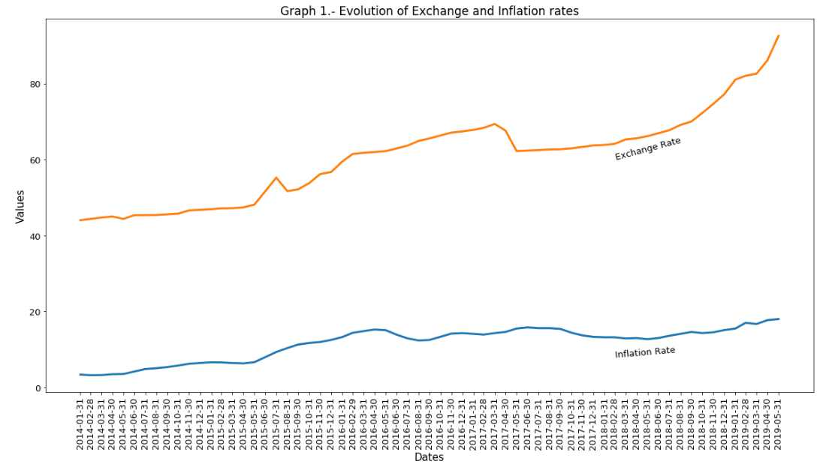
INFLATION
The Exchange rate dramatically increased from around August 2015 thru April 2017. Then from May 2017 to date, it kept on growing exponentially.
Inflation is a measure of the percent increase or decrease of goods and services prices in an economy.
In a country where the national market is largely provided by imports, inflation is very likely to be imported as well.
As Graph 1 shows it: An increase in the Exchange rate is almost always accompanied with a similar increase in the Inflation Rates, and vice versa.

Slide 10
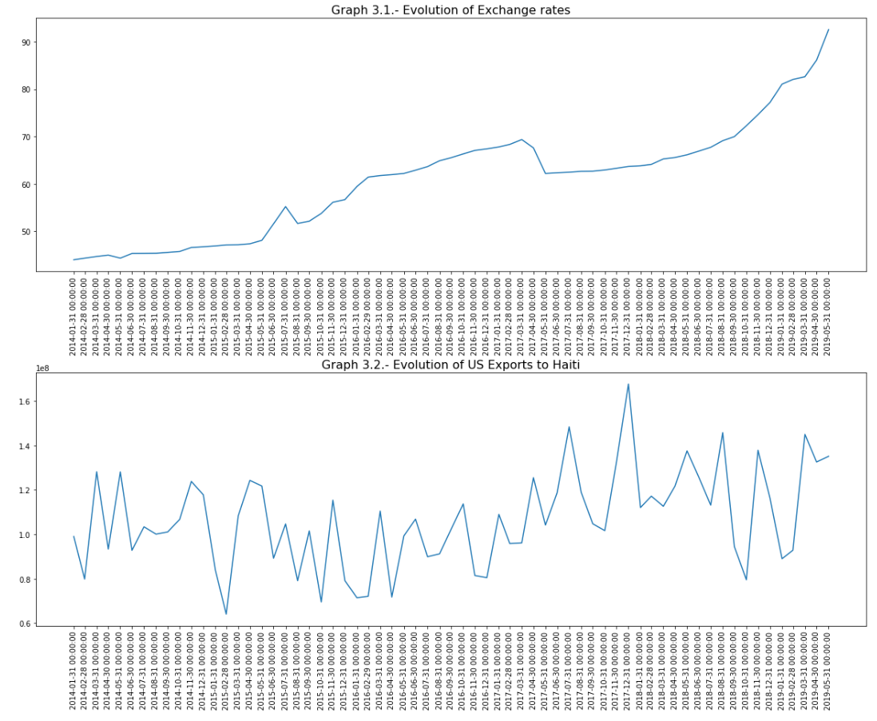
IMPORTS
FROM THE USA
The dollar is the currency that is used by Haitian importers to pay for goods the USA export into Haiti. The Haitian imports increasing in one month should mean Haitian importers needed more dollars in October thru December.
The need for dollars normally makes the dollar scarce and expensive. Since gourdes are needed to acquire dollars, then the price of U$ 1 should increase proportionally.
But this is not what has been observed. For example in December 2017, the Imports hit a historical high (U$ 160M), but the ExchangeRate did not dramatically increase as expected.
The Exchange rate behaving so weirdly may give the economists reasons to believe that some major agents in the economy might be hoarding the dollar, or using other artificial strategies to override the market forces.

Slide 11
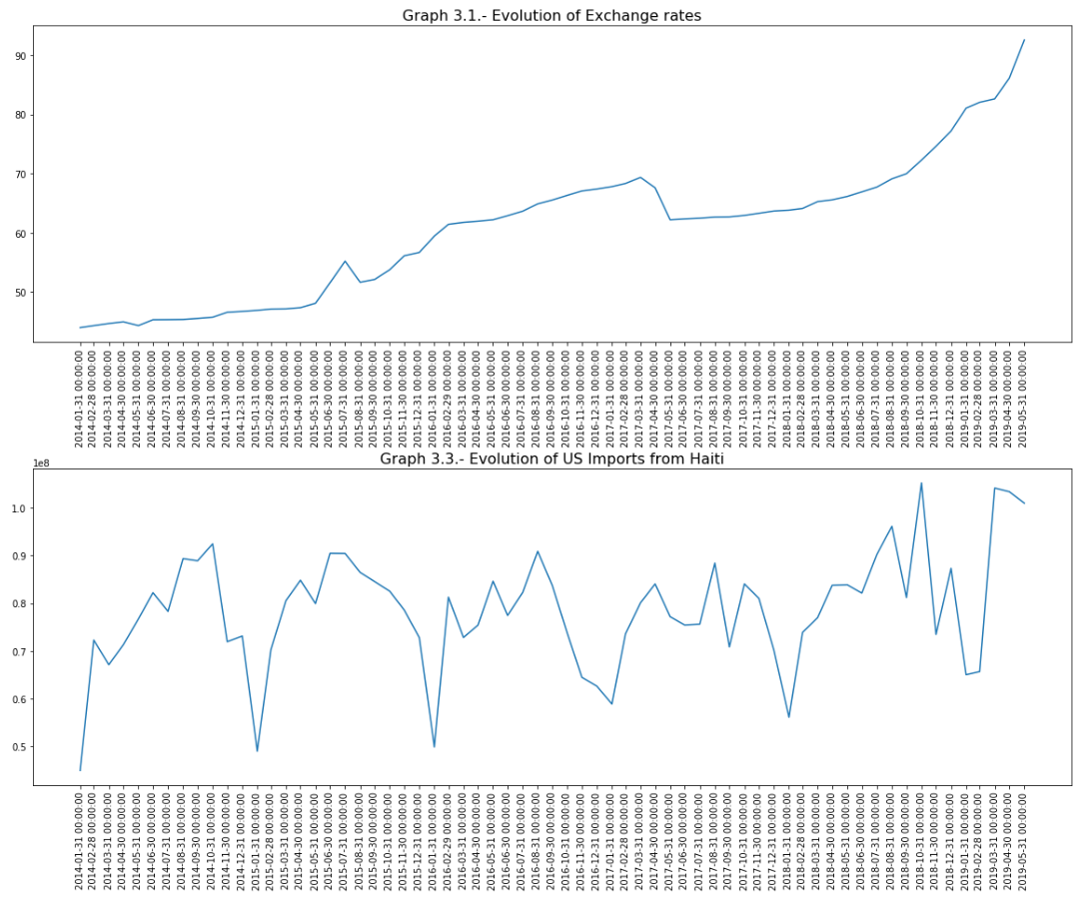
EXPORTS
TO THE USA
The dollar is the currency that enters the Haitian economy when Haitian Exporters sell goods to the USA.
We can use the money we get for exporting to create more goods and export more. But visibly, the State and the economic elite have chosen to live on a service-and-imports-based market economy.
Actually dollars earned from exporting to the USA might be mainly used to finance imports from the USA. For example in December 2017, the Exports dropped to $ 60M. As graph 3.2 can testify, the imports also dropped (from 160M in December 2017 to U$ 110M in January 2018).
The last but not the least thing to notice is that the US Demand for Haitian products is seasonal: they always drop low in January of every year.

Slide 12
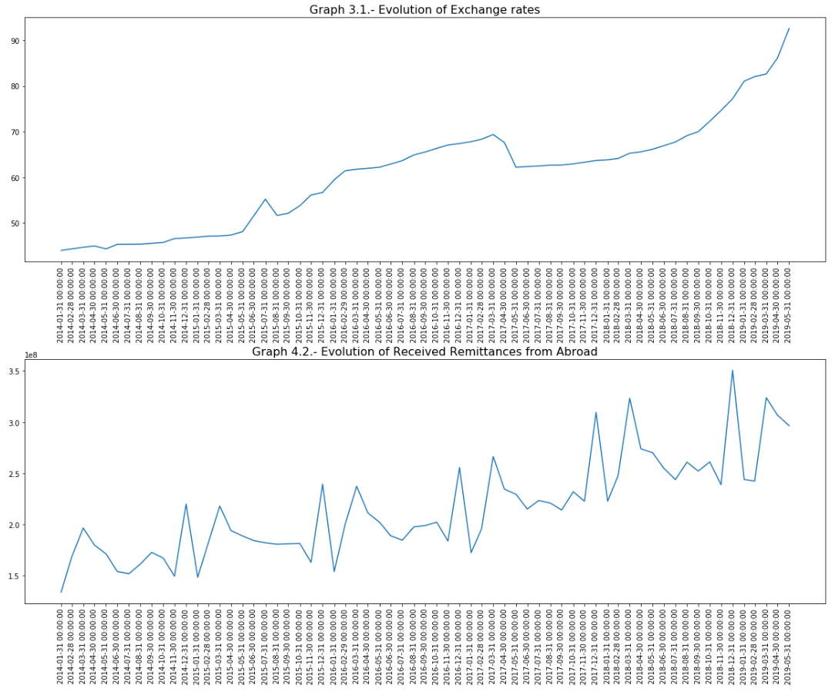
REMITTANCES FROM ABROAD
Remittances are a factor that helps Haitian consumers in fighting against Inflation on the short term (Haiti: Selected Issues and Statistical Appendix, IMF, 2007), but it actually becomes a source of inflation in the long run.
Like the Inflation, the Remittances tend to have the exact same trend as the Inflation. However, on the contrary of the Inflation, they are seasonal.
This means Remittances may spike up around U$ 260M in March and around U$ 275M in December. And brutally drop around 179M in January, 192M in November.

Slide 13
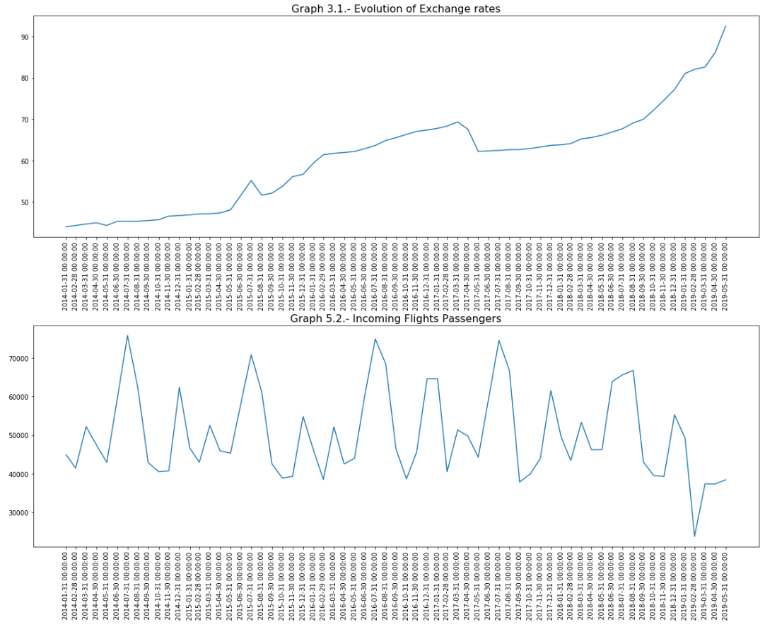
DEBARKMENTS
Passengers land in the Toussaint Louverture International Airport seasonally. Graph 5.2 shows a spike every year in July, with around 72k passengers debarking from regular international flights. In comparison, the average over the whole period under study is of 50k.
The number of Passengers debarking tends to evolve reciprocally to the Exchange rate’s trend. This means also that every time the Rates spike, there are less and less passengers landing in the Toussaint Louverture International airport.
So the Exchange rates spiking is bad for industries such as Tourism, Airlines companies and also for families expecting their relatives to come in and see them.
On the other hand, the exchange rates spiking is a great thing for any particular, major economic agent or business that has chosen to venture on the US Money Market of Services in Haiti.

Slide 14
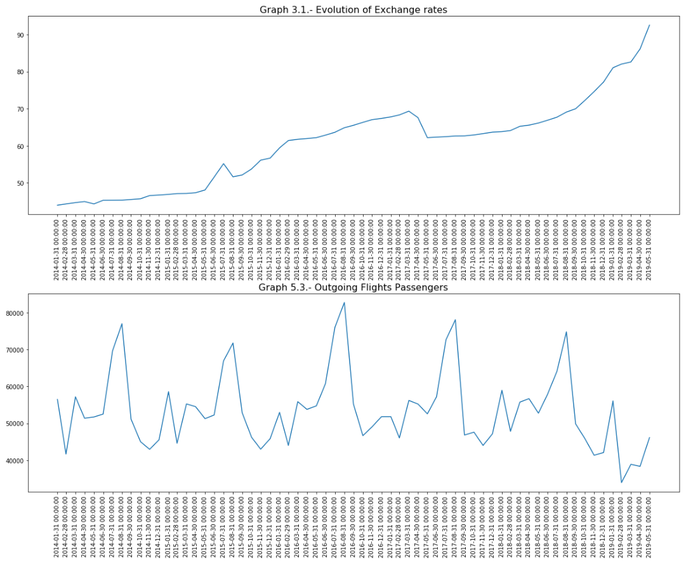
EMBARKMENTS
Passengers take off from Toussaint Louverture International Airport seasonally, too. Graph 5.3 shows a spike every year in August, with around 76k passengers leaving the country in average froaboard regular international flights. In comparison, the average over the whole period of study is 54k.
The above also means most of those passengers might be those who came in July who actually leave in August.
The number of Passengers embarking also tends to evolve reciprocally to the Exchange rate’s trend, but less steeply than those debarking. This means also that every time the Rates spike, there are less and less passengers landing in the Toussaint Louverture International airport.

Slide 15
FORECASTING THE EXCHANGE RATES!

Slide 16


TWO MODELS HAVE BEEN ESTIMATED
Model 1
Model 1 accounts for all the factors analyzed before, and studies their evolution from January 2014 thru Feburary 2019.
The vector of those variables accounts for up to 4 lags. This means, the value of each factor during the last 4 months are being used by the machine in order to learn how the factors have been evolving and predict how they are more likely to evolve in the next month.

Slide 17
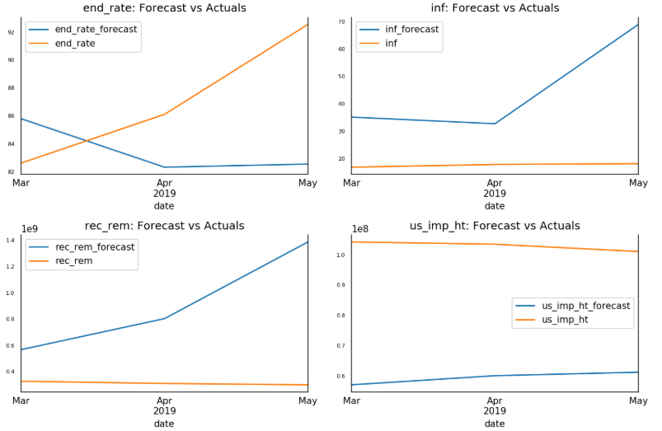
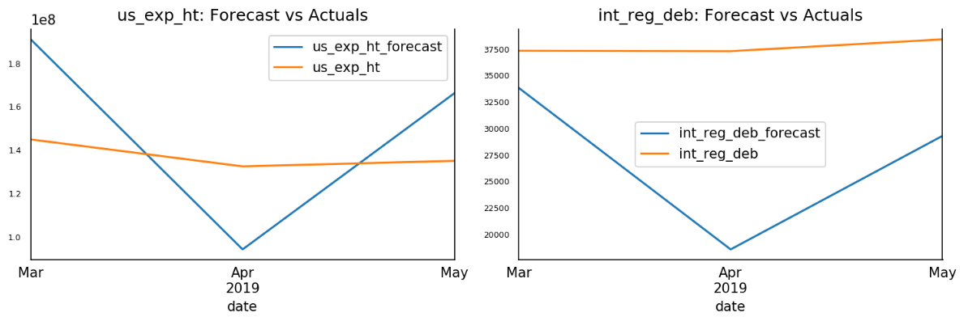
TESTING MODEL 1
When tested over March thru May 2019, Model 1 gives precise prediction on the first two months for the Exchange Rate, and fails at predicting the other factors.
This corresponds to a mean absolute percent error of 6.35% and a root mean square error of 6.43.
The lesser the error, the better the model predicts. The other factors have root mean squared error of the order of tens to thousands and millions.

Slide 18
TWO MODELS HAVE BEEN ESTIMATED
Model 2
Model 2 accounts for all the factors analyzed before but not the Flights Data (Embarkments and Debarkments), and studies their evolution from December 2009 thru December 2019.
The Flights Data was dropped because it didn’t go beyond May 2019, and we wanted to try another model with less factors but more lags and see how well it fares compared to the first.
The vector of those variables accounts for up to 12 lags. This means, the value of each factor during the last 12 months are being used by the machine in order to learn how the factors have been evolving and predict how they are more likely to evolve in the next month.

Slide 19
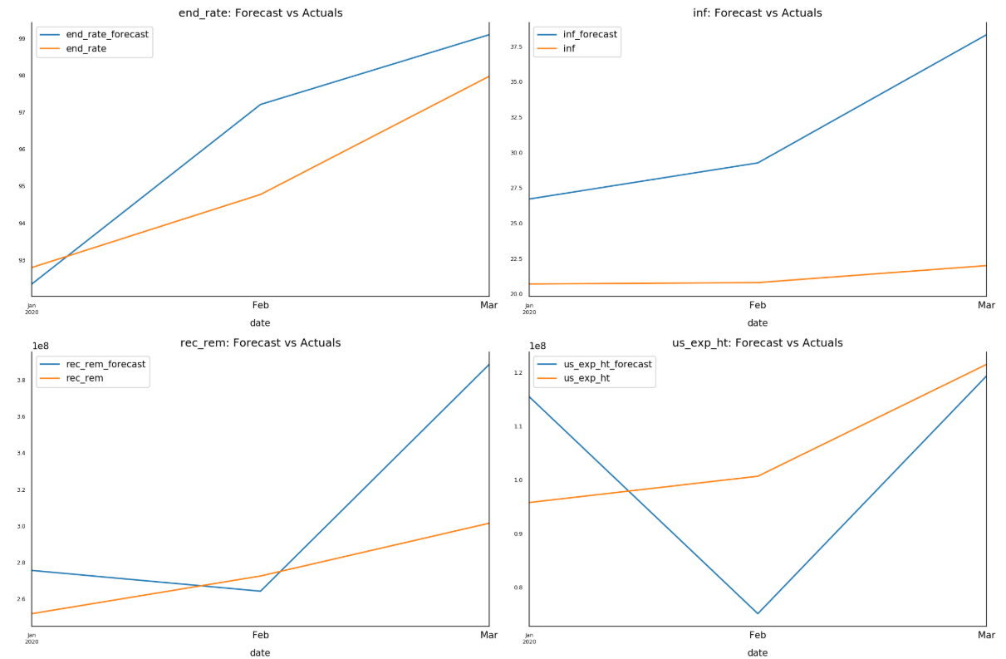
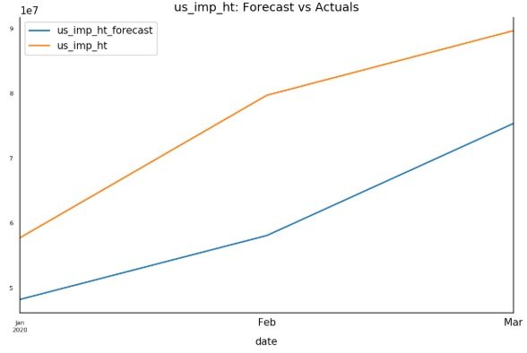
TESTING MODEL 2
When tested over January thru March 2019, Model 1 gives slightly better and more precise prediction on these three months for the Exchange Rate, and doesn’t fare any better than model at predicting the other factors.
This corresponds to a mean absolute percent error of 1.40% and a root mean square error of 1.57.
The lesser the error, the better the model predicts. The other factors have root mean squared error of the order of tens to thousands and millions.

Slide 20
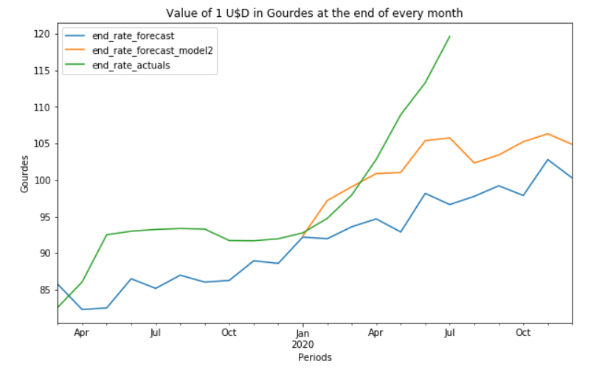
COMPARISON OF THE EXCHANGE RATE MODELS
OVER THEIR RESPECTIVE SPAN OF PREDICTION
Both models systematically predict Exchange Rates lesser than the actual values. Which, again would sustain the hypothesis that other factors, probably under the control of a group of agents, might be influencing the Exchange rates out of the economic sphere.
However the curve of the second model tends to be closer to the actual values than that of the first model. Which would make us trust the second model more than the first.

Slide 21
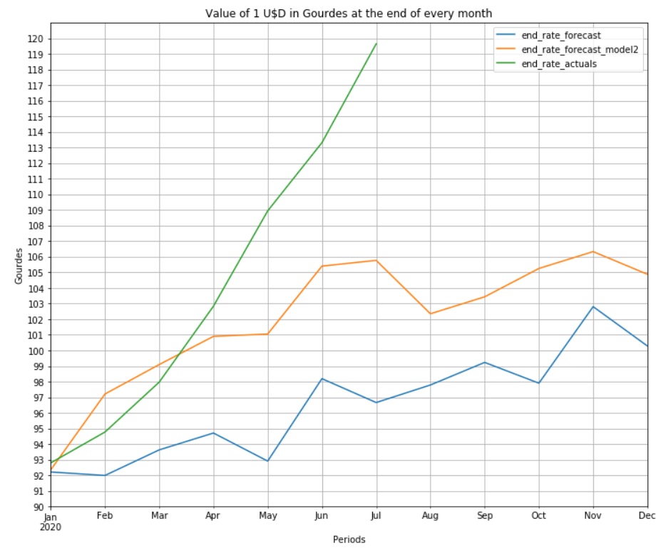
CONLUSION & RECOMMENDATIONS
This last graph is a zoom in order to appreciate the precision of the prediction. We’re expecting a drop in the Exchange rate at the end of August, but as stated before, some factors we might have not identified might be influencing the rate informally.
So although we trust the second model more, it would definitely be interesting to include more factors. The Flights Data could still be included, if Data from April 2019 thru today could be included.
Also, the State and the BRH could think of implementing more strict regulations of the commercial banks and the International Trade in Haiti. We’re leaving in a capitalist country, but complete laissez-faire won’t be advantageous to our economy.
Consumers and entrepreneurs worrying about the exchange rate could potentially start hoarding, or getting in the Exchange rate business by selling or lending dollars a bit lesser than the price of the commercial banks. But this should be a provisory solution, because otherwise the economy would never be sustainable on the long-run and could get completely out of control.

Slide 22

MERCI
Grégory PINCHINAT
Data Scientist
Statistician / Economist
gregpinchy@gmail.com
Github link to this project:
https://github.com/gregpinchy/creative-capstone-AA.git
1
D’AVOIR
SUIVI!

